Slide 1
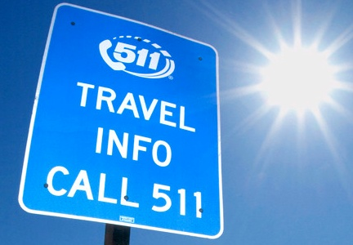
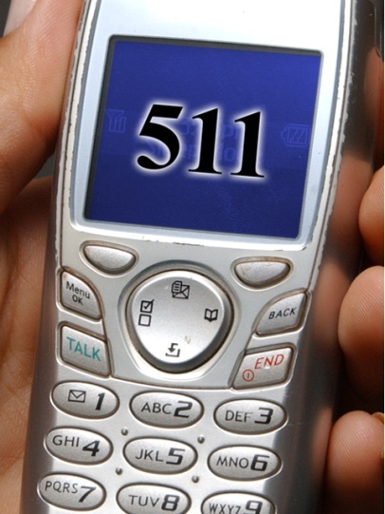
Kansas City 511
Kansas City
ITS Symposium
May 6, 2009
Presented by:
Barb Blue, ATIS/511 Program Manager
Kansas Department of Transportation (KDOT)
Notes:
I’d like to thank Jason for inviting me today and providing the opportunity to share with you about ATIS, specifically progress on 511 in Kansas City.

Slide 2
Today’s Agenda
Traveler Information (ATIS)
  What is ATIS?
  511 Background
  Kansas City 511 Update
Steve – Big Picture of ATIS for the 21st Century
Notes:
In my very limited time today, I have been asked to update you on plans for 511 in Kansas City. However, I’d like to start with some very brief comments about ATIS, provide you a little background about 511 and then update you on progress regarding Kansas City 511.
Following my presentation, Steve Kuciemba from Parsons Brinkerhoff will be casting a vision for ATIS in the 21st Century.

Slide 3
What is ATIS?
Advanced Traveler Information System
ATIS: The means to disseminate information, both broadcast and personalized, from ITS infrastructure to the traveling public via telephone, website, vehicles, dynamic message signs, highway advisory radio and other devices.
An integrated extension of ITS – the “face of
ITS”
Notes:
Whenever I am asked to talk about 511, an ATIS system, I like to start by briefly defining ATIS so we’re all on the same page. In particular, I wanted to start here today because we’re at an ITS Symposium and in the current day you can’t really talk about traveler information without talking about ATIS and its relationship to ITS.
ATIS is an abbreviation for Advanced Traveler Information
System…which simplistically means:
The use of advanced technology to disseminate information, both broadcast and personalized, from ITS infrastructure to the traveling public via telephone, website, vehicles, dynamic message signs, highway advisory radio and other devices.
- Includes multi-modal information
Since ATIS is the ability to disseminate information from our ITS infrastructure, it needs to be an integrated extension of ITS. It becomes the “face of ITS” because it becomes the information that travelers directly interface with or see, hear and use.

Slide 4
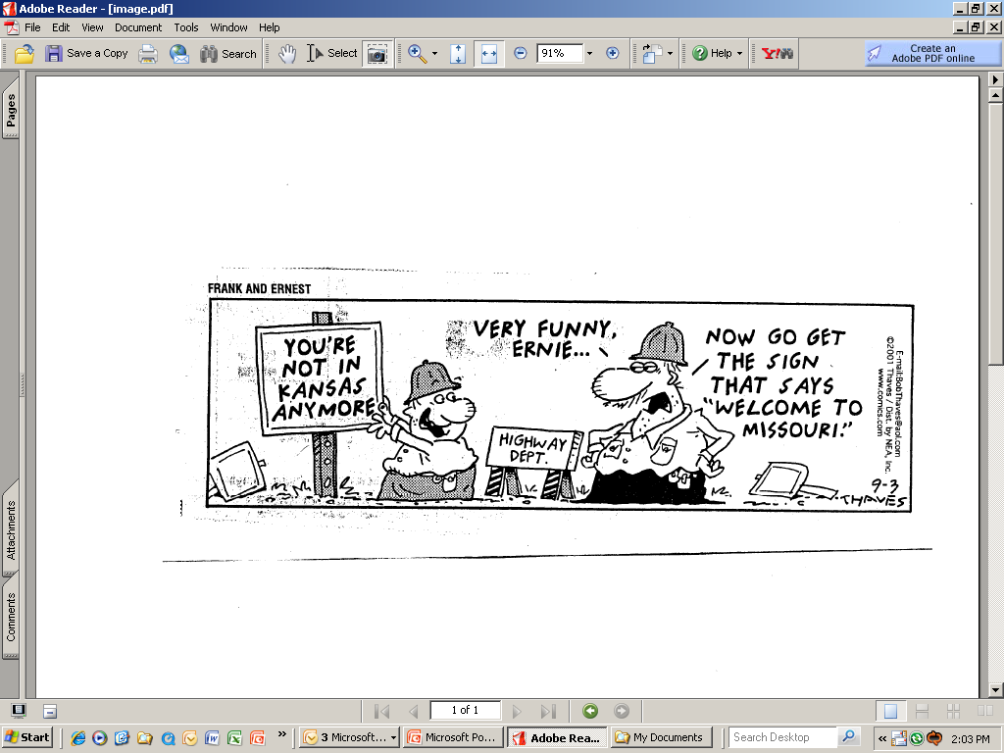
ATIS – An Improved “Face”
Notes:
ATIS provides an improved “face” to traveler information. Lest we forget how far we’ve come with ITS and ATIS, one of my favorite cartoons, can help remind us! Not only that, I thought this cartoon was particularly fitting for talking about Kansas City.
It used to be that the concept of traveler information was a sign on the road and maybe a map on the seat of your car—or if you were lucky, some “local person” could tell you about the closed road and the detour. ITS/ATIS enables us to not only provide en route information but advanced information for travel planning.

Slide 5
511 Background
In July 2000, FCC granted 511 as the national travel information number in response to US DOT’s petition for an N11 number for travel information
National Rationale
  Simplify access to information—one easy-to-remember nationwide number
  Improve Information and User experience
  Overcome Obstacles for providing travel information
Notes:
Many of you may know about 511, but there may be some of you that don’t.
511 is the national abbreviated dialing code for Traveler Information.
In July 2000, the FCC granted 511 as the national travel information number in response to US DOT’s petition for a national N11 number for travel information.
National Rationale
Simplify access to information – at the time of the US DOT petition, there were over 300 numbers nationally for travel information. This created confusion for travelers because as they traveled across jurisdictions they didn’t know how to get information. One easy-to-remember nationwide number would fix this.
Improve Information and User experience – the national goal was to provide more consistent and better information that is needed and wanted by the traveling public
Overcome Obstacles for providing travel information
Area code expansion making 7 digit numbers less plausible
Increasingly mobile society—want more information in a timely manner, often in multiple locations

Slide 6
511 Background
KDOT began planning for 511 in Kansas
in 2000
KDOT’s original 511 work plan called for
the statewide 511 system to include the
greater Kansas City metro area
After further assessment, the plan was
revised to add the KC metro later
Began research/planning for KC in 2007
Notes:
KDOT began planning for 511 in Kansas in 2000, shortly after 511 was granted as the national traveler information number
KDOT’s original 511 work plan called for the statewide 511 system to include the greater Kansas City metro area
After determining that neither Kansas nor Missouri had data to support 511 for the metro area (KC Scout was not yet deployed), the plan was revised to add the KC metro later

Slide 7
Kansas Statewide 511
Deployed in January 2004
Outsourced system hosted by Meridian (ASP)
Covers Kansas State Highway System (Turnpike and Interstate, US, State highways)
Route/segment-specific info
Accessible 24/7/365 from landline or cellular phones from anywhere in the U.S.
Free to callers (cell minutes may apply)
Interactive User Menu easy to use by voice or keypad commands
Ongoing enhancements – a work in progress
Notes:
Deployed in January 2004
Outsourced system hosted by Meridian Environmental Technology, Inc., a surface-transportation company in Grand Forks, ND. Meridian is on contract as the ASP
Is a Statewide Service--provides information for the KS State Highway System that includes Interstate, US, or State highways as well as KS Turnpike routes.
All information is Route/segment-specific and includes:
Road conditions – surface road conditions
Roadway Information (Construction/work zone closures and detours and incidents on primary routes)
Weather – transportation weather that focuses on visibility, wind, precipitation and temperature
Fully interoperable with 511 in NE—NE is the only adjacent state that currently has 511 operational. KS 511 provides full information for the NE Highway system and vice versa (I’ll talk more about interoperability later)
Referral numbers for other surrounding states—CO, MO and OK (again, I’ll talk more about interoperability later)
Alerts – provided by a floodgate with the option for broadcasting one each for Amber Alerts, General Transportation Alerts or Homeland Security Alerts. When active, callers hear the alerts immediately following the opening introduction and they cannot interrupt or “barge through”
Accessible 24/7/365 from landline or cellular phones from anywhere in the U.S. by calling 511 in Kansas, 1-866-511-KDOT (5368) from anywhere in the U.S. or 711 for the hearing impaired
Free to callers (cell minutes may apply)
User Interface/Features
Interactive menu by voice or keypad commands
Easy-to-use 3-tier Menu Structure
Help Menu
Comment Line
Ongoing enhancements – a work in progress

Slide 8
Kansas City 511
Primary Stakeholder Meetings
Preliminary Information/Assessment
  Who are we serving?
  Why: Benefits of a Kansas City 511 System
  Goals
  Priorities
  Needs
  Issues
  System Deployment options
Notes:
Regional Stakeholder Communications
Stakeholders identified
Series of Meetings
Relationship building
Input/Ownership
Feedback
We began by looking at some preliminary information and assessment and sought answers to:
Who are we serving?
Why: Benefits of a Kansas City 511 System
Goals
Priorities
Needs
System Deployment options
Issues
Unfortunately, time doesn’t permit me to go into detail about these but I have provided you with a handout with some high level bullet points that captures the results of discussions with stakeholders and research to date

Slide 9
Kansas City 511
Who Are We Serving?
  Local, resident travelers
  Interstate (through) Travelers
  Stakeholder needs (esp. funders)

Slide 10
Kansas City 511
Benefits of A Kansas City System
  Easy access to information across state lines
  Provide information travelers need/want to make informed decisions
    Metro traveler needs are different than rural
  Increased customer service/satisfaction
  Accurate, reliable information can provide opportunity for changed traveler behaviors
  Stakeholder Public Relations
Notes:
Benefits of A Kansas City System
Easy access to information across state lines
Provide information travelers need/want to make informed decisions
Metro traveler needs are different than rural
Urban travelers want more convenience-related information (delays, congestion, etc) whereas rural travelers are more concerned with safety or assistance-related information, particularly during inclement weather
Urban (esp. major urban) area travelers want public transportation information, such as transit
Increased customer service/satisfaction
Accurate, reliable information can provide opportunity for changed traveler behaviors
Stakeholder Public Relations

Slide 11
KC System Goals
Easy access and use from both states
Timely, accurate information
Increased detail and types of information
Easy, reliable user access (no dropped calls)
Reliable system operations
Cost-effective system operations/maintenance
No /minimal staff additions
Public relations for Stakeholder sponsors

Slide 12
KC System Priorities
Near real time information
Low operating costs
System reliability
Content:
  Weather-related road conditions
  Roadway information (traffic, work zone, incidents, etc)
  Weather

Slide 13
KC System Needs/Issues
System “ownership”
System Support (in-house or outsourced)
Content (data and information dissemination)
Operations/Maintenance Requirements & Support
Interoperability
System Type
User Interface (menu, content, structure)
System capacity (average and peak usage)
Costs
Funding
Companion Web site?
Notes:
System “ownership” – and stakeholder cooperation/support or “ownership”
In identifying the stakeholders for the project and in meeting with them, one topic of discussion was “Who would “own” 511 in Kansas City and ultimately be responsible?
Stakeholders agreed that the primary stakeholders for the region are:
KDOT/MoDOT
KC Scout
MARC
and perhaps KCATA
Generally, stakeholders agreed that the system should be “owned” and operated by stakeholders with vested interests in regional jurisdictions and needs, such as the above stakeholders.
In follow up to this I have met with MARC and KCATA to discuss their interest, desire and ability to “host” the system if needed. MARC has said they would be willing to consider it. I have not had a response from KCATA to date.
System Support (in-house or outsourced)
Content (data and information dissemination)
Operations/Maintenance Requirements & Support
Interoperability
System Type
Fully automated vs. Operator support
In-house or outsourced
Use of call transfers
Required personnel for system support
User Interface (menu, content, structure)
System capacity (average and peak usage)
Costs
Funding
Companion Web site?

Slide 14
Kansas City 511
Regional Stakeholders identified
Stakeholder Meetings/Feedback:
  Want/support 511 for the metro region
  Provided input for preliminary information
  Priority content identified:
    Road Conditions
    Weather
    Road Closures
    Work Zone Information
    Traffic/Congestion (travel times)
    Incidents
    Transit
Airport
Events (transportation impact)
Ride Share
Parking/Park & Ride
Disaster/Evacuation
AMBER Alert

Slide 15
Kansas City 511
Stakeholder Feedback
  Other Content
    Ozone Alerts
    Safety Campaign Information
    Tourism

Slide 16
Deployment Options
Meridian Hosted Solutions
  Integrate within the existing Kansas 511 system, with interoperability for MO
  Separate KC system within shared infrastructure
  Separate KC system without shared infrastructure
Traffic.com Solution
Other Solutions
  Separate KC system – hosted by “owner”
  Separate KC system – VoIP
  Separate KC system – pay-per-minute

Slide 17
Deployment Options
Requirements
  Extensible
  Locally maintained menu and content
  No dropped calls
  Accommodate multiple modes
  Seamless across state line
  Unattended operation
  Adhere to National 511 Guidelines

Slide 18
Deployment Options
Developed high level Concept of Operations
Address potential System “owners”
Considerations for each option
  Benefits (pros)
  Disadvantages (cons)
  Goals/Needs and Priorities
  Estimated Costs and Cost/benefit
  Issues
  Time-line (include Phases if proposed)
Notes:
We are now proceeding (with the help of Telvent Farradyne) with the completion of the details required for the Concept of Operations and requested recommendations.
I have identified 3 basic options or approaches for deploying the system:
Integrate within the existing Kansas 511 system, with interoperability for MO
Separate KC system – hosted by “owner” (in-house)
Separate KC system – outsourced
The Concept of Operations will address for each option:
Benefits (pros)
Disadvantages (cons)
Goals/Needs and Priorities
Estimated costs and cost/benefit
Issues

Slide 19
Research Conclusions
Separate outsourced regional System
Primary Stakeholders : KDOT, MoDOT, MARC, KC Scout and KCATA
System needs/requirements are beyond the scope of KC Scout
Request for MARC to lead the administration of the system
KDOT 511 Program Manager assigned to lead the technical project management and implementation
KDOT and MoDOT have committed to participation of other staff needed to assist
Notes:
Separate outsourced regional System
Seamless access from both sides of the state line
Fully interoperable with the Kansas 511 system
Primary Stakeholders : KDOT, MoDOT, MARC, KC Scout and KCATA
System needs/requirements are beyond the scope of KC Scout
Request for MARC to lead the administration of the system
KDOT 511 Program Manager assigned to lead the technical project management and implementation
KDOT and MoDOT have committed to participation of other staff needed to assist

Slide 20
Next Steps
Confirm MARC as system administrator
Develop agreements with primary stakeholders
Finalize system functional requirements
RFP – Select system host
Begin system deployment process

Slide 21
For more information, contact:
Barb Blue
ATIS /511 Project Manager
Bureau of Transportation Information, KDOT
bblue@ksdot.org
785-291-3818

